Slide 1
Topics Discussed in the Section
Process-to-Process Communication
Addressing: Port Numbers
Encapsulation and Decapsulation
Multiplexing and Demultiplexing
Flow Control
Error Control
Congestion Control
Connectionless and Connection-Oriented Services
TCP/IP Protocol Suite

Slide 2
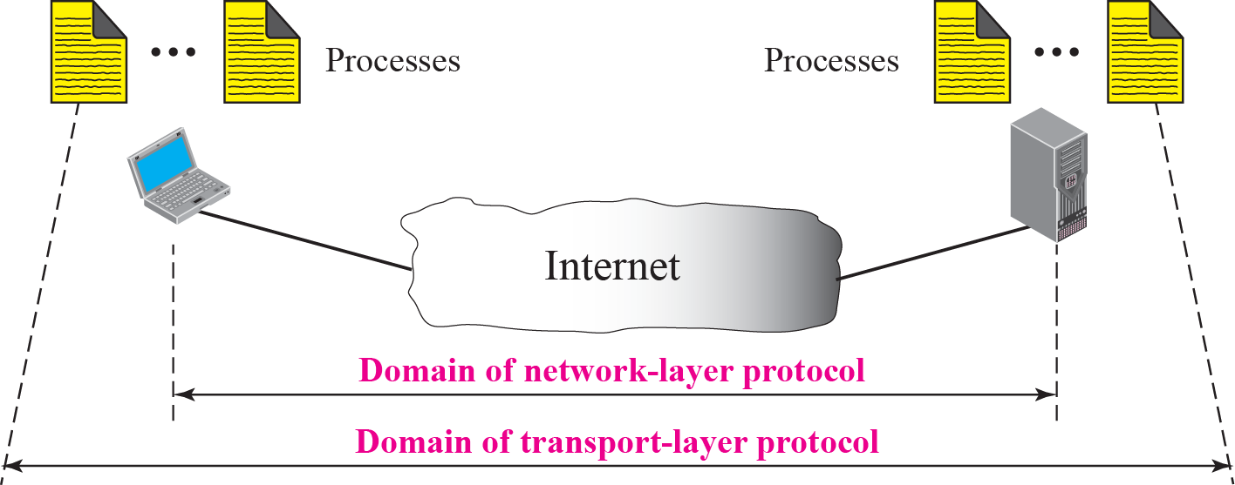
Figure 13.1 Network layer versus transport layer
TCP/IP Protocol Suite

Slide 3
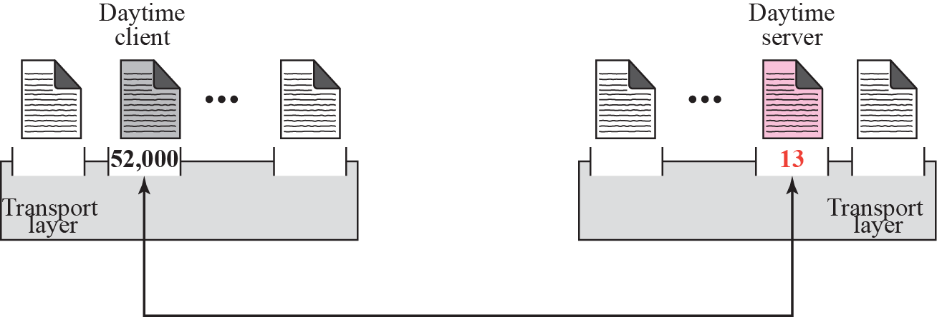
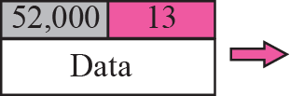
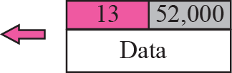
Figure 13.2 Port numbers
TCP/IP Protocol Suite

Slide 4
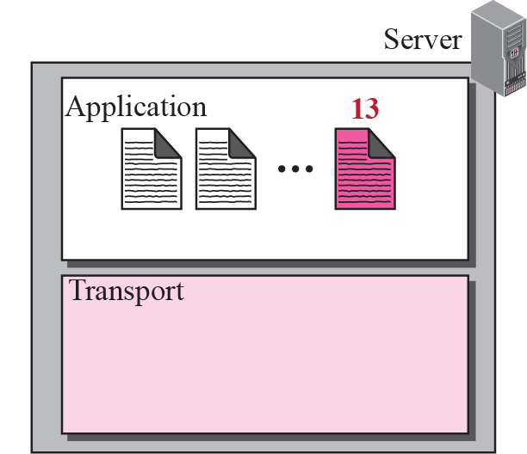
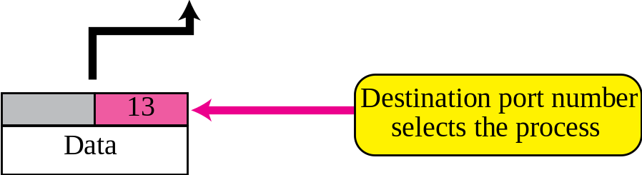
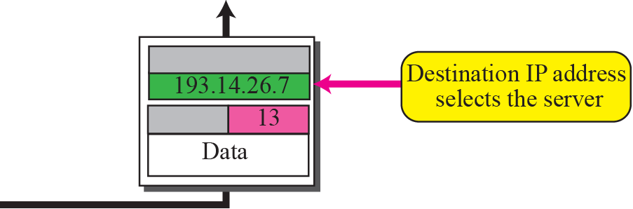
Figure 13.3 IP addresses versus port numbers
TCP/IP Protocol Suite

Slide 5
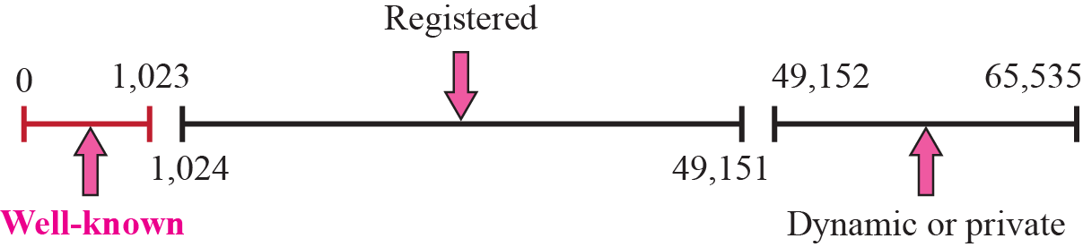
Figure 13.4 ICANN ranges
TCP/IP Protocol Suite

Slide 6

Note
The well-known port numbers are
less than 1,024.
TCP/IP Protocol Suite

Slide 7
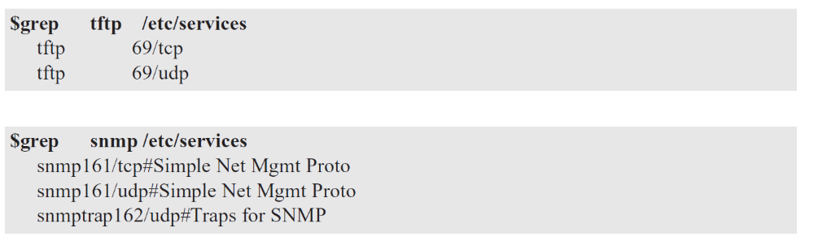
Example 13.1
In UNIX, the well-known ports are stored in a file called /etc/services. Each line in this file gives the name of the server and the well-known port number. We can use the grep utility to extract the line corresponding to the desired application. The following shows the port for TFTP. Note that TFTP can use port 69 on either UDP or TCP. SNMP (see Chapter 24) uses two port numbers (161 and 162), each for a different purpose.
TCP/IP Protocol Suite

Slide 8
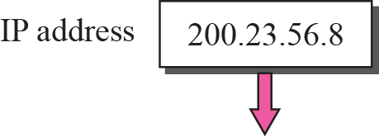
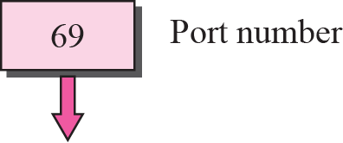

Figure 13.5 Socket address
TCP/IP Protocol Suite

Slide 9
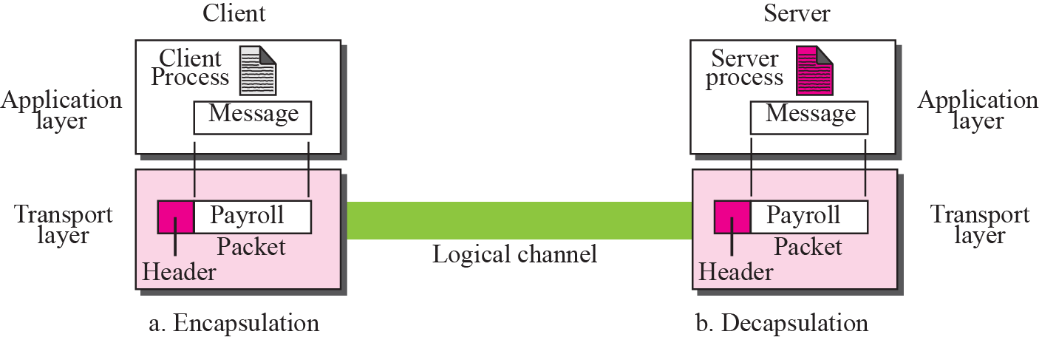
Figure 13.6 Encapsulation and decapsulation
TCP/IP Protocol Suite

Slide 10
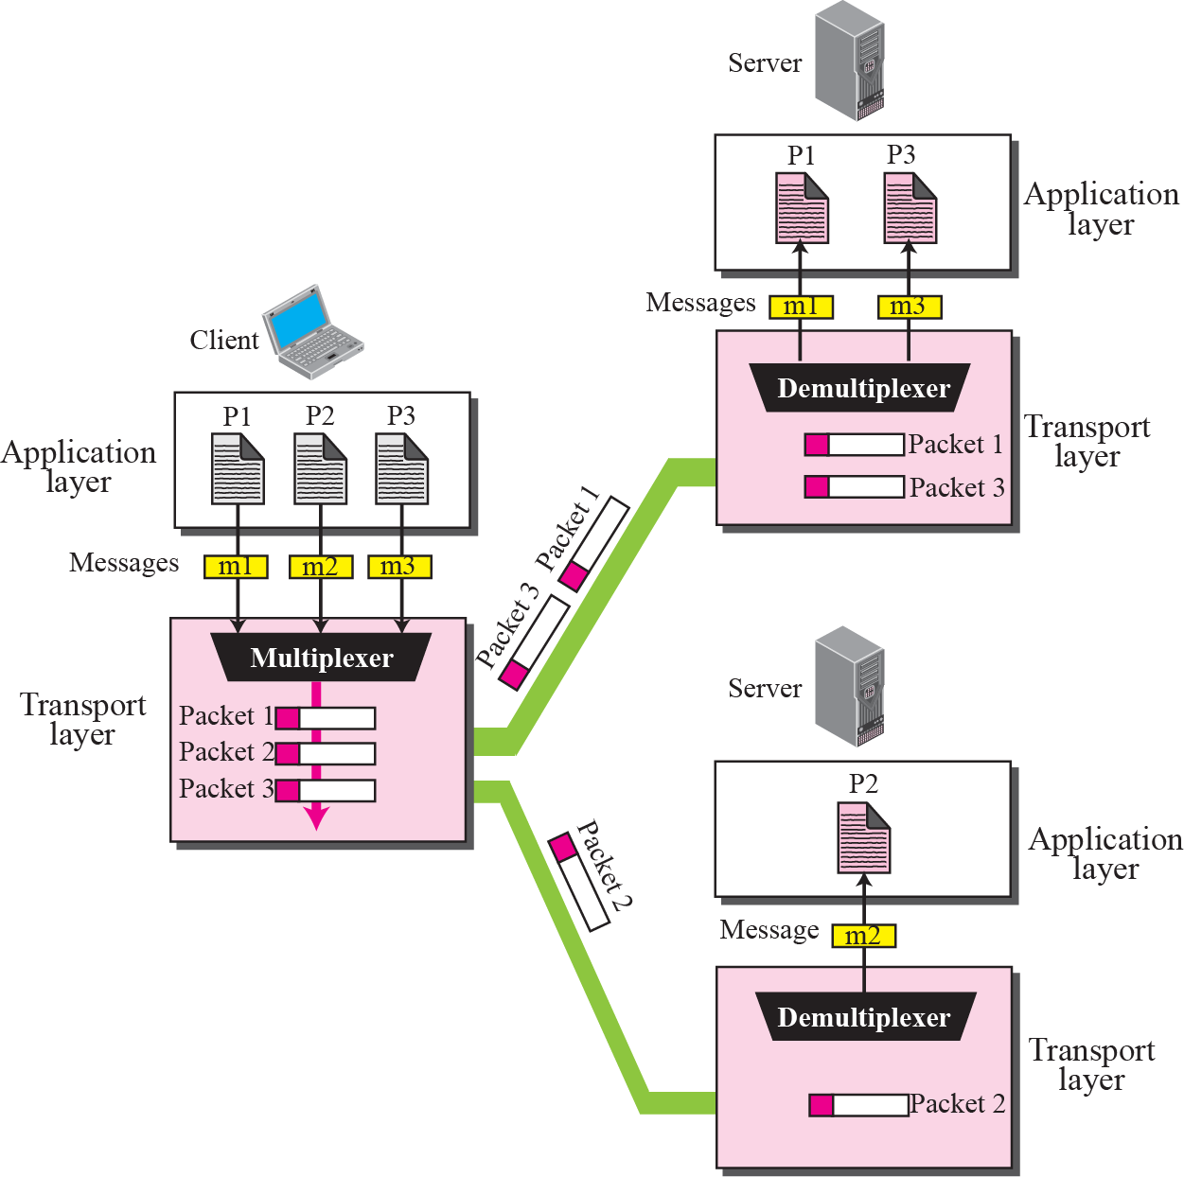
Figure 13.7 Multiplexing and demultiplexing
TCP/IP Protocol Suite

Slide 11
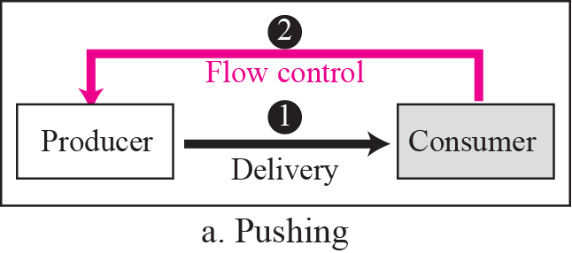
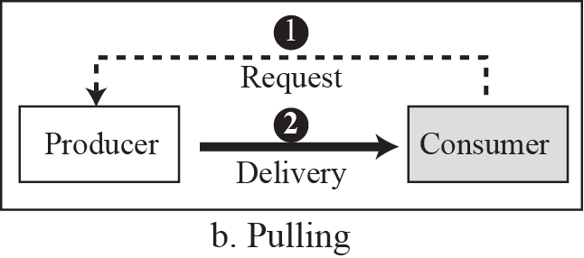
Figure 13.8 Pushing or pulling
TCP/IP Protocol Suite

Slide 12
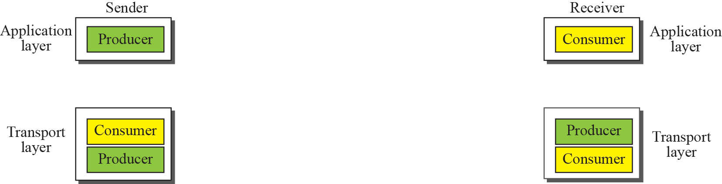

Figure 13.9 Flow control at the transport layer
TCP/IP Protocol Suite

Slide 13
Example 13.2
The above discussion requires that the consumers communicate with the producers in two occasions: when the buffer is full and when there are vacancies. If the two parties use a buffer of only one slot, the communication can be easier. Assume that each transport layer uses one single memory location to hold a packet. When this single slot in the sending transport layer is empty, the sending transport layer sends a note to the application layer to send its next chunk; when this single slot in the receiving transport layer is empty, it sends an acknowledgment to the sending transport layer to send its next packet. As we will see later, this type of flow control, using a single-slot buffer at the sender and the receiver, is inefficient.
TCP/IP Protocol Suite

Slide 14
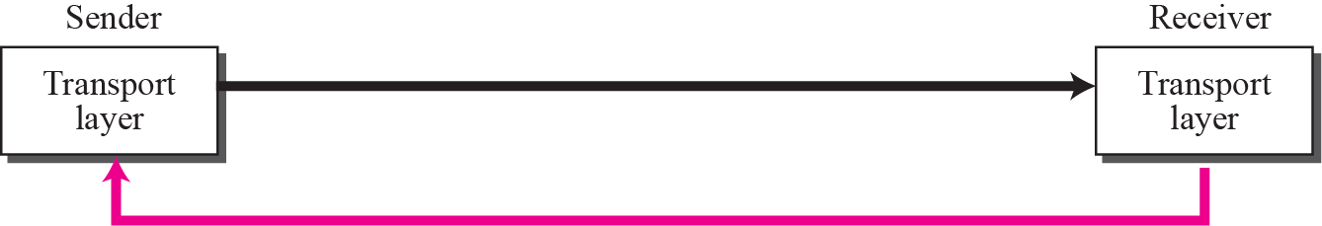
Figure 13.10 Error control at the transport layer
Packets
Error Control
TCP/IP Protocol Suite

Slide 15
Note
For error control, the sequence numbers are modulo 2^{m}, where m is the size of the sequence number field in bits.
TCP/IP Protocol Suite

Slide 16
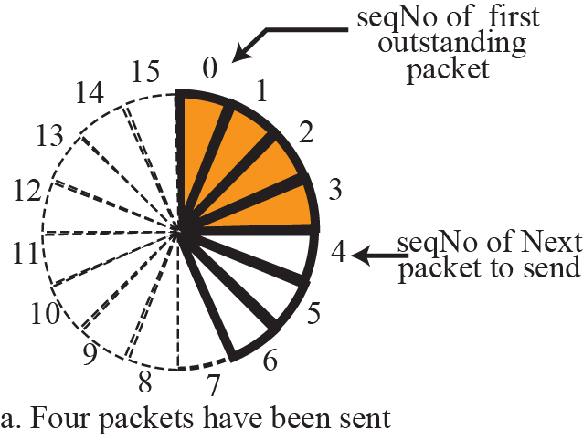
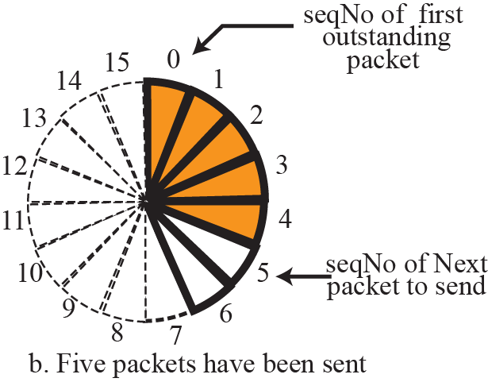
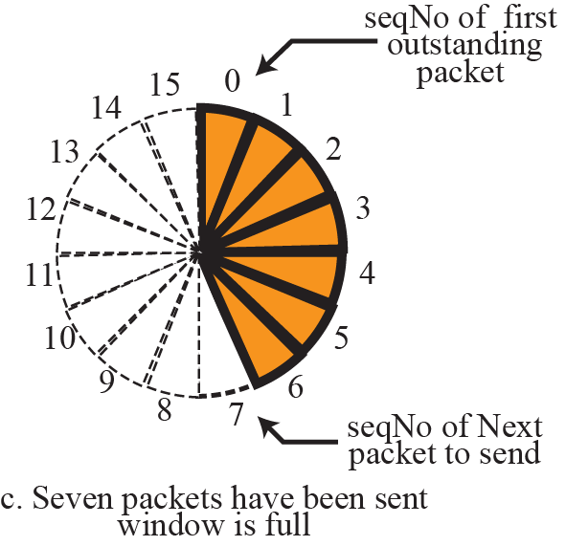
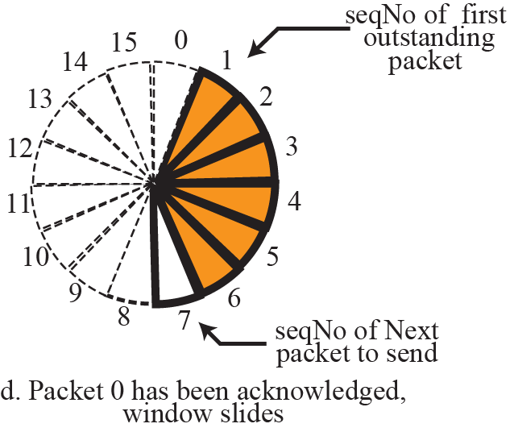
Figure 13.11 Sliding window in circular format
TCP/IP Protocol Suite

Slide 17
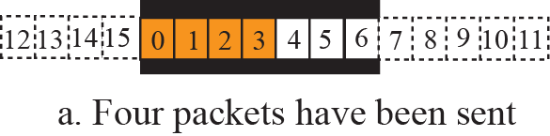
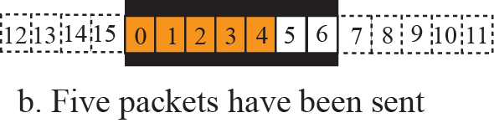
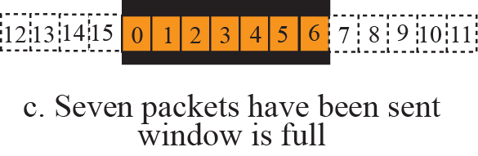
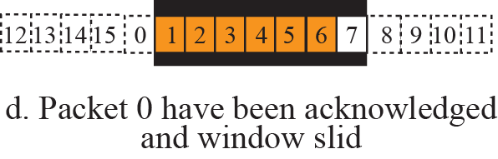
Figure 13.12 Sliding window in linear format
TCP/IP Protocol Suite

Slide 18
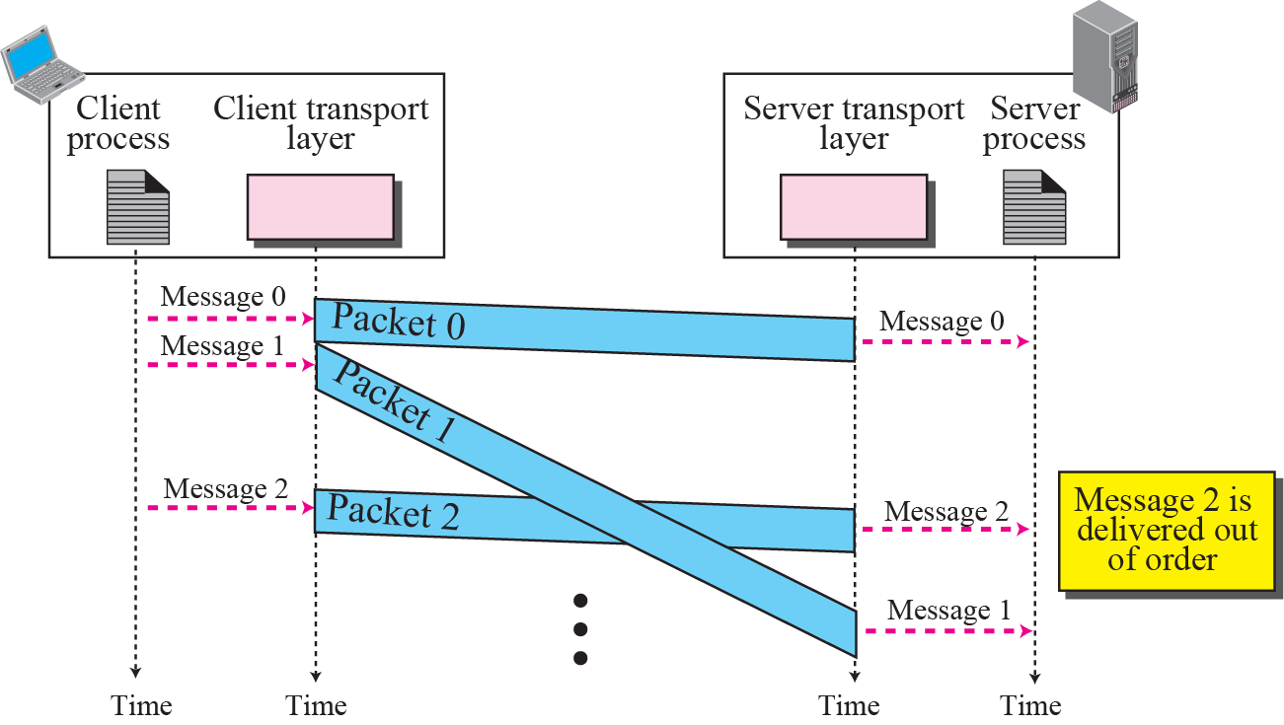
Figure 13.13 Connectionless service
TCP/IP Protocol Suite

Slide 19
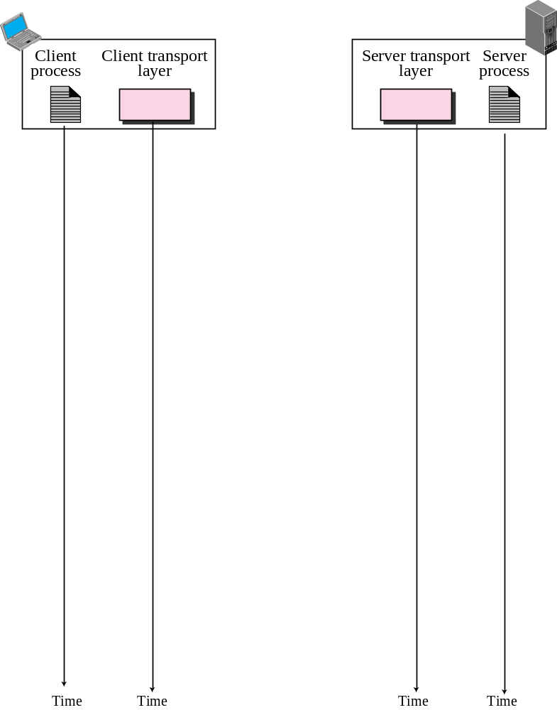
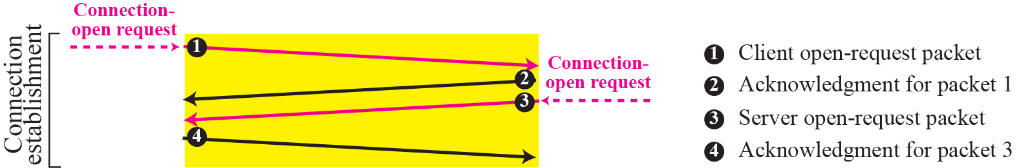
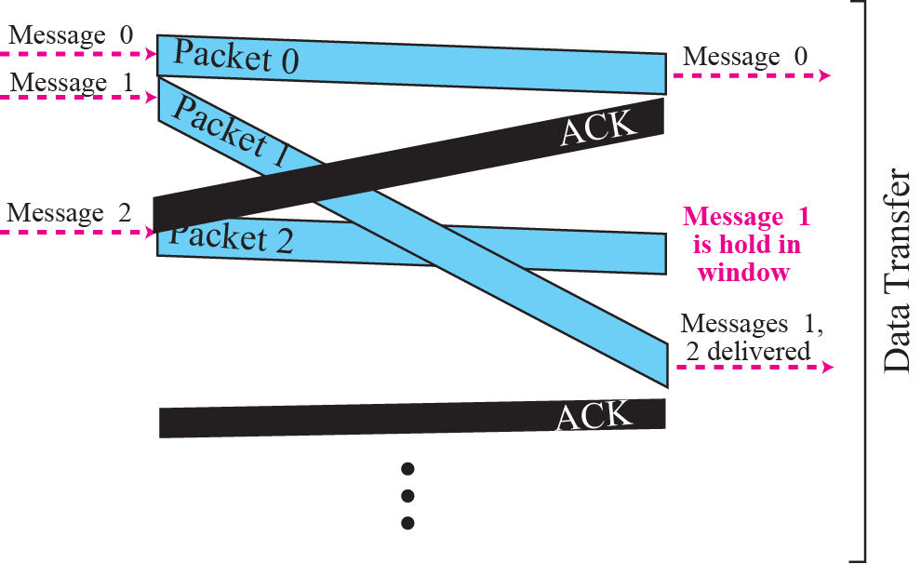
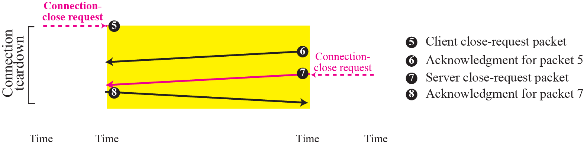
Figure 13.14 Connection-oriented service
TCP/IP Protocol Suite

Slide 20
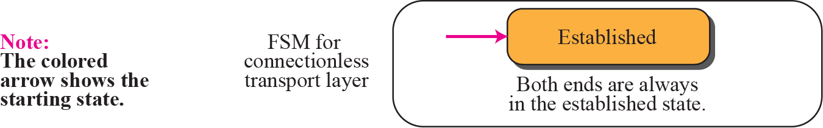
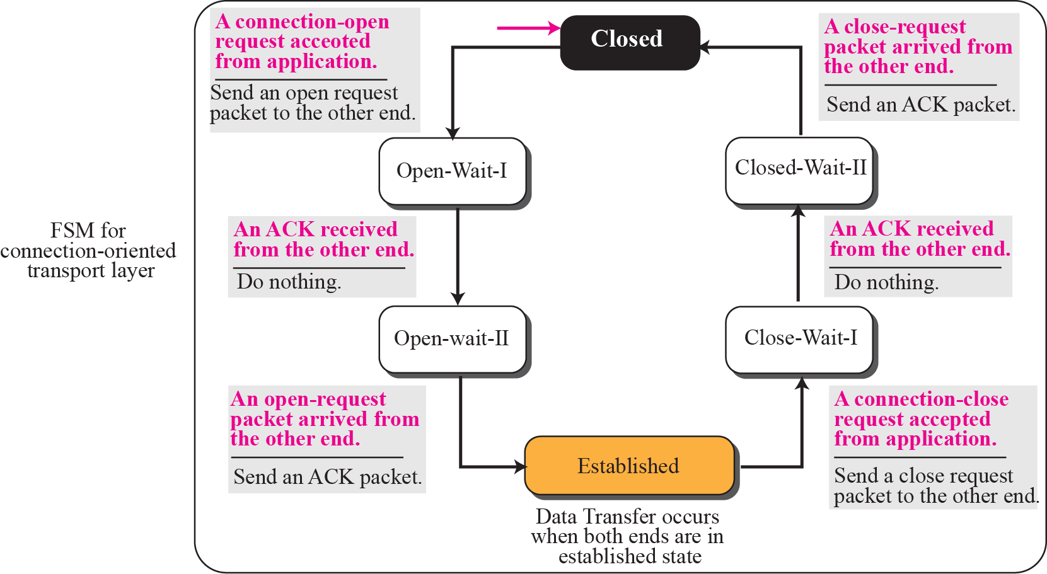
Figure 13.15 Connectionless and connection-oriented services as FSMs
TCP/IP Protocol Suite

